Slide 2
Fun with JS proxies
Goran Šiška
Head of QA @ Adacta

Slide 3
ComeFrom
Edsger Dijkstra's Go To Statement Considered Harmful.
R. Lawrence Clark’s We don't know where to GOTO if we don't know where we've COME FROM…

Slide 4
ComeFrom
5 INPUT X
10 PRINT 'Result is :’
15 PRINT X
20 COME FROM 10
25 X = X * X
30 RETURN

Slide 5
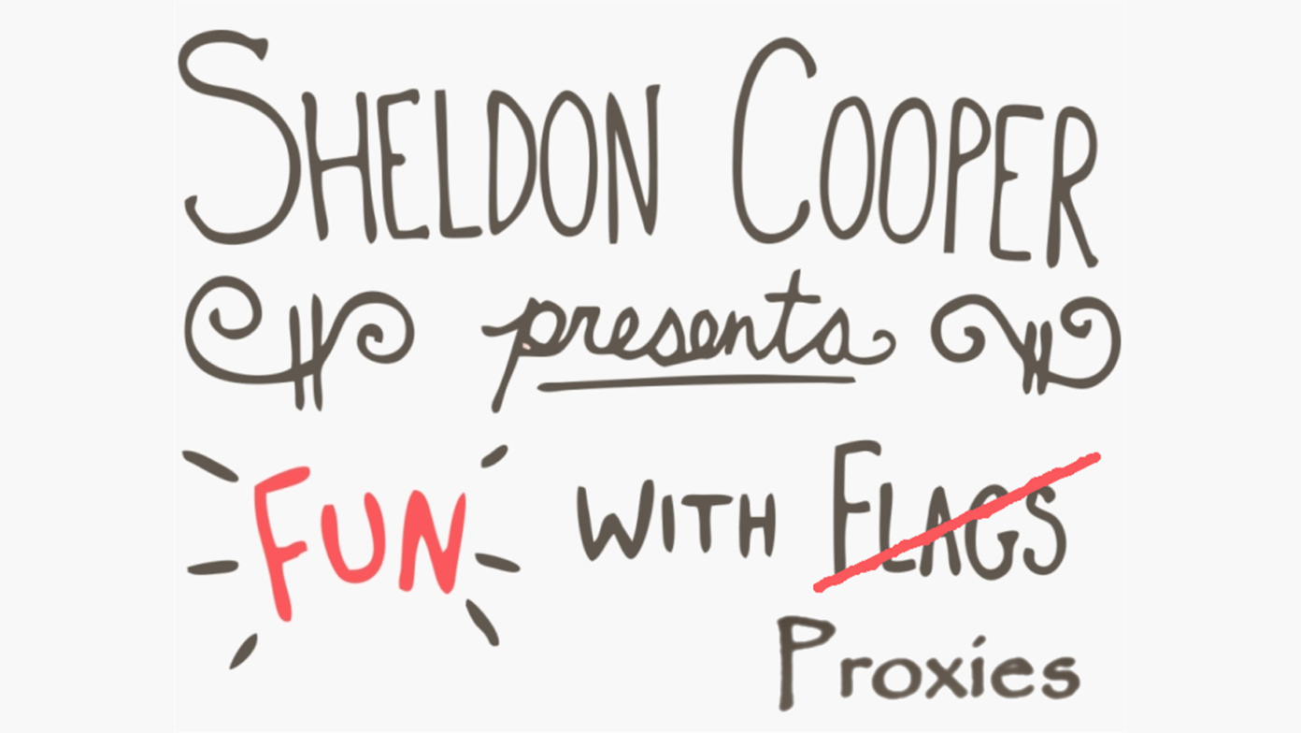

#ntk23

Slide 6
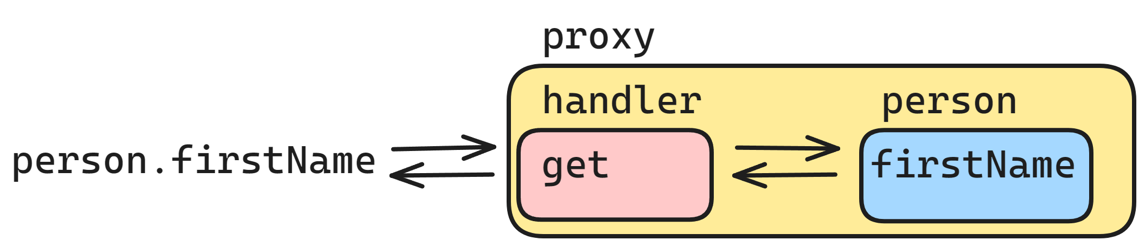
Proxy

Slide 7
Internal Method | Trap/Reflect | When
[[Get]] | get | Reading a propery
[[Set]] | set | Writing to a property
[[HasProperty]] | has | in operator
[[Delete]] | deleteProperty | delete operator
[[Call]] | apply | function call
[[Construct]] | construct | new operator
[[GetPrototypeOf]] | getPrototypeOf | Object.getPrototypeOf
[[SetPrototypeOf]] | setPrototypeOf | Object.setPrototypeOf
[[IsExtensible]] | isExtensible | Object.isExtensible
[[PreventExtension]] | preventExtensions | Object.preventExtensions
[[DefineProperty]] | defineProperty | Object.defineProperty(ies)
[[GetOwnProperty]] | getOwnPropertyDescriptor | Object.getOwnPropertyDescriptor for..in Object.keys/values/entries
[[OwnPropertyKeys]] | ownKeys | Object.getOwnPropertyNames/Symbols for..in Object.keys/values/entries

Slide 8
Questions
Default value?
Readonly property?
Hide a property?
Memoization?

Slide 9
Answers
Default value? | get
Readonly property? | set
Hide a property? | get, ownKeys, getOwnPropertyDescr.
Memoization? | apply

Slide 10
Final though
Not everything that saves lines, saves time.

Slide 11
Sources
Repo: GoranSiska/funwithproxies (github.com)
Specs: Proxy - JavaScript | MDN (mozilla.org)

Slide 12
This is not school, but we
love to get grades. Please fill out our
questoineers and leave
us your feedback. You may even win some
cool rewards.

